Slide 1
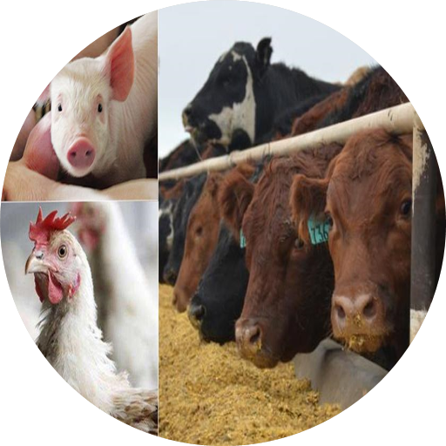
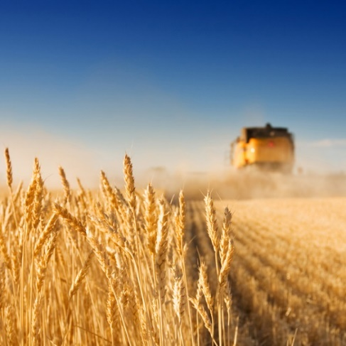
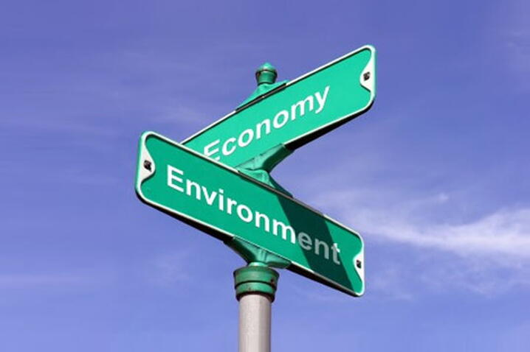
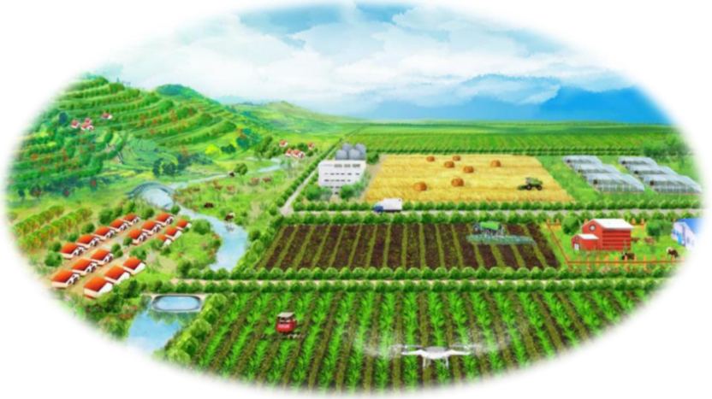
Towards sustainable food system in China: transformation options and their connections to the food-land-water-climate nexus
PhD candidate: Weitong Long
Supervisors: Dr. Xueqin Zhu, Dr. Hans-Peter Weikard, Prof. Oene Oenema, Prof. Yong Hou
Sep 10, 2024
1

Slide 2
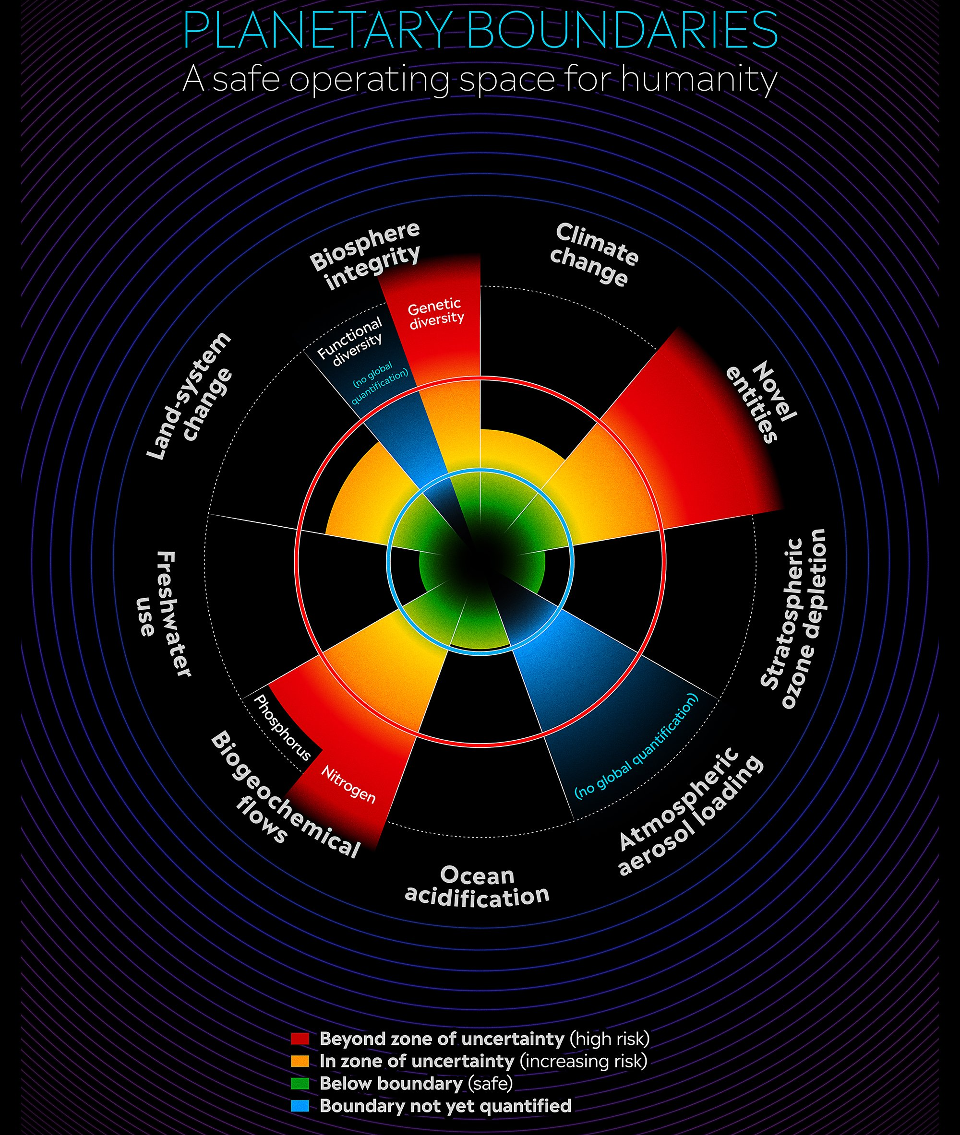
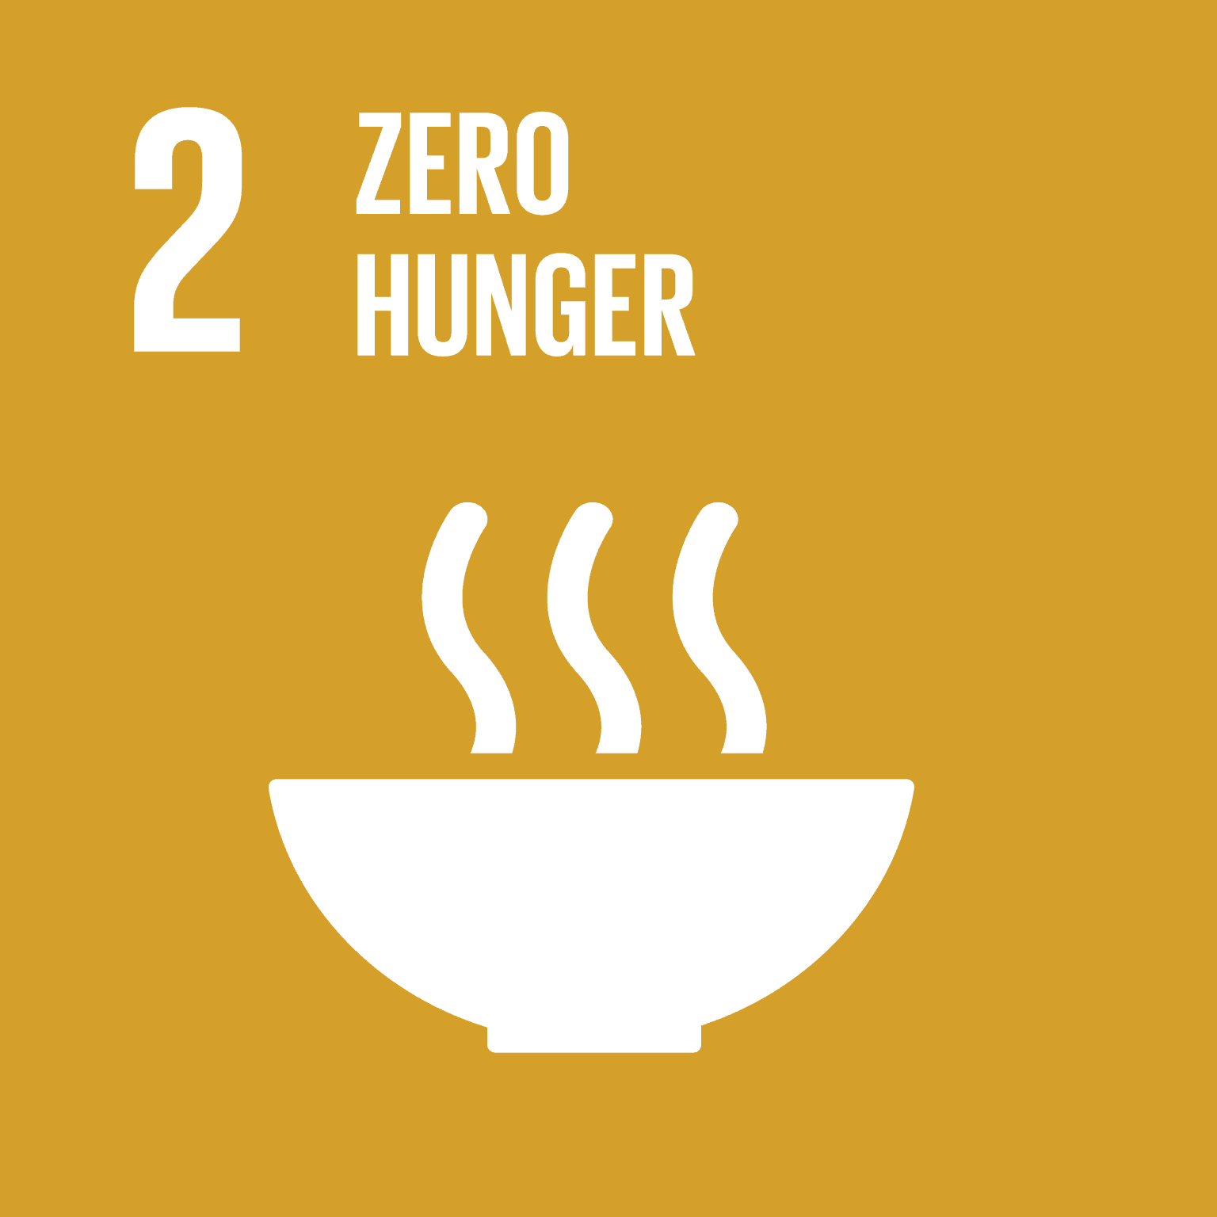

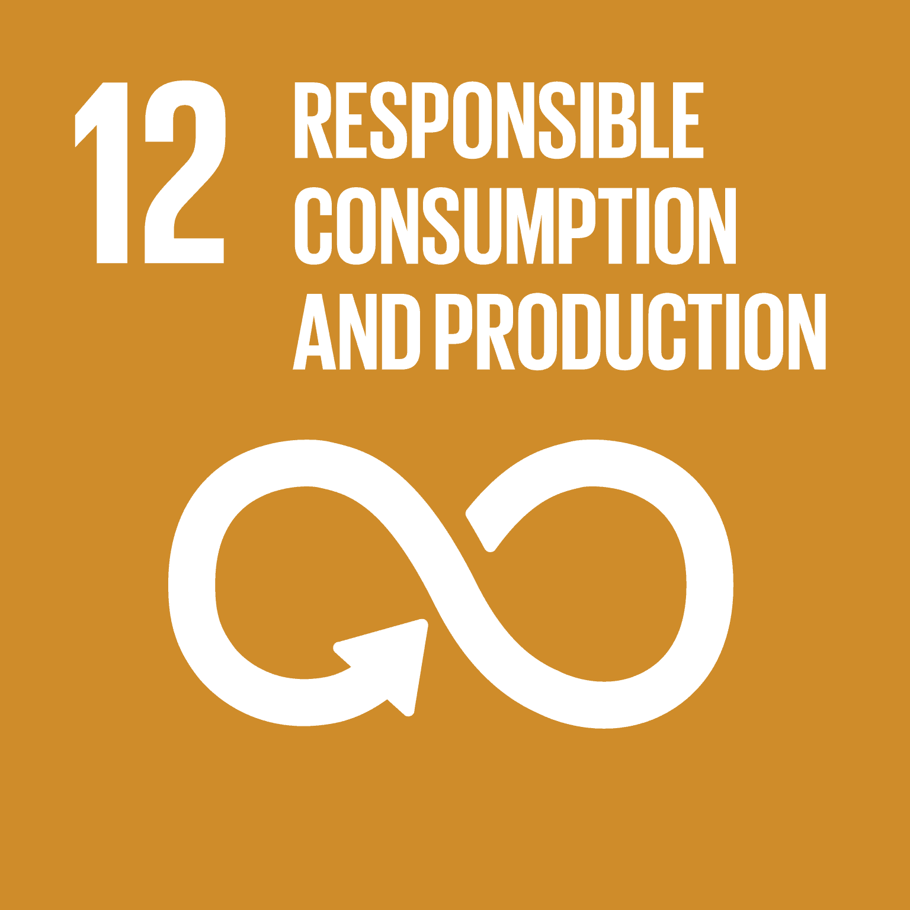

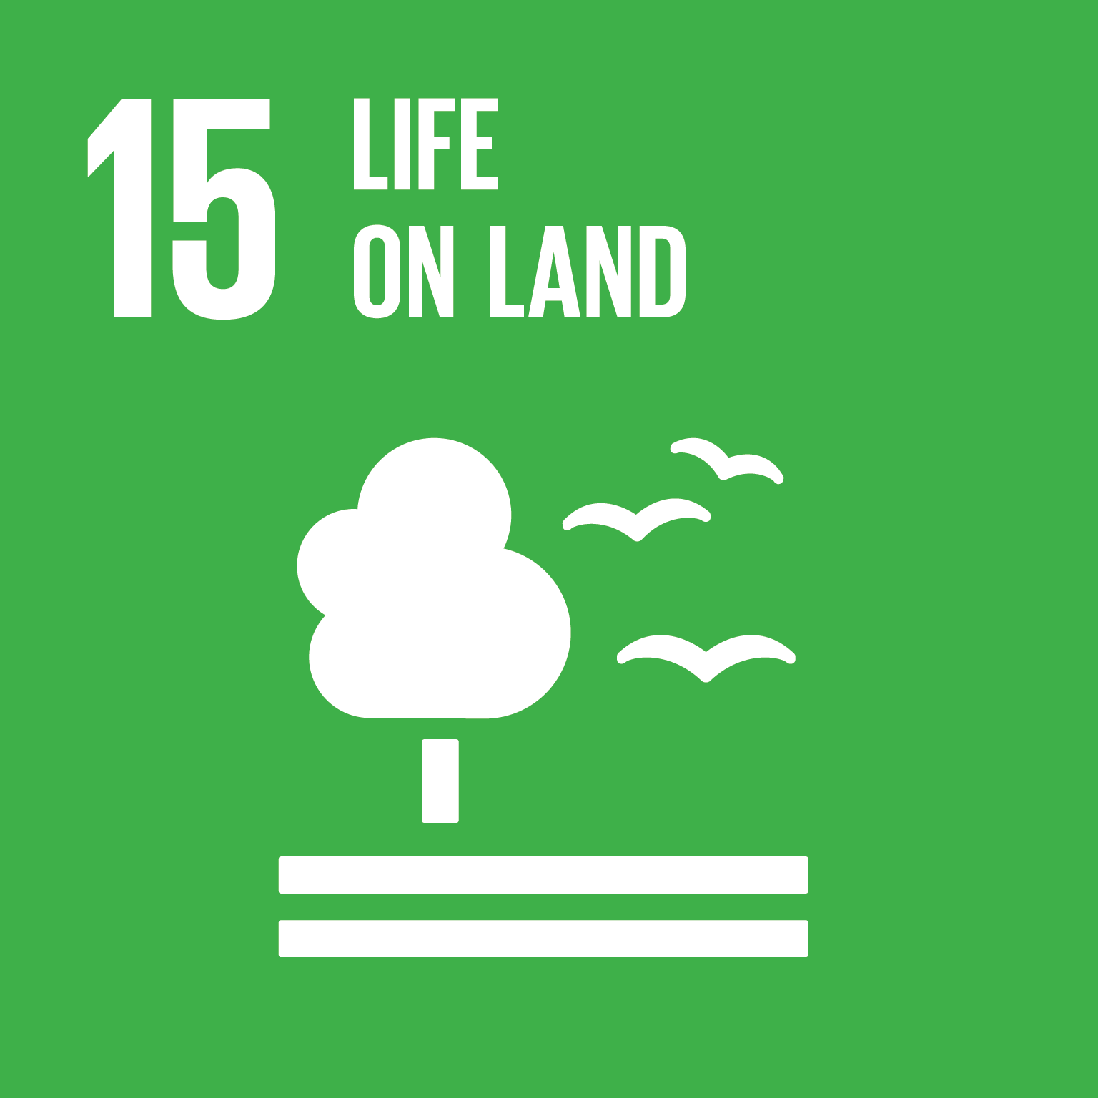
Food system transformation is critical for respecting PBs and achieving SDGs
Planetary boundaries (PBs)
Sustainable Development Goals (SDGs)
(Richardson et al., 2023; UN, 2015; Doelman et al., 2022)
Notes:
Scientists identified a set of nine planetary boundaries that must not be breached if we wish to avoid catastrophic consequences for nature and humanity.
The United Nations have set 17 SDGs to achieve a better and more sustainable future for all people.
The food system is a key driver of all four exceedances and, thus, is critical for respecting PBs and achieving SDGs.

Slide 3
Problem statement
Food, land, water, and climate have, in the past, often been treated as individual and disconnected sectors (Johnson et al., 2019).
Pathways and measures to achieve one or more specific PBs/SDGs may cause trade-offs or unexpected changes for other PBs/SDGs and/or for other sectors/regions in our society.
It remains unclear how solutions to one PB/SDG affect other PBs/SDGs in the food-land-water-climate nexus.

Slide 4
Central research questions
What are the environmental and economic impacts of food transformation options?
How will these options cause trade-offs and synergies in the food-land-water-climate nexus?
Food
Climate
Land
Water

Slide 5

An integrated environmental-economic framework based on applied general equilibrium (AGE) models
Database:
1）GTAP version 10 database (2014 as the base year)
2）Region- and sector-specific environmental impact database
Regions: China and its main food and feed trading partners (MTP, including Brazil, the United States, and Canada)
Sectors: Detailed food-related sectors and aggregated non-food sector
Notes:
A nexus approach is needed to understand the synergies and trade-offs for alternative solutions.

Slide 6

PhD research outline
Dietary structure change
Cleaner cereals production
Emission restriction policy
Upcycling food waste as feed in monogastric livestock
1. Theoretical framework & application
2. Supply-side
option
3. Supply- & demand-side
options
4. Supply- & demand-side
options
Combing crop and livestock supply-side as well as demand-side measures
Combining food, land, water, and climate scenarios

Slide 7
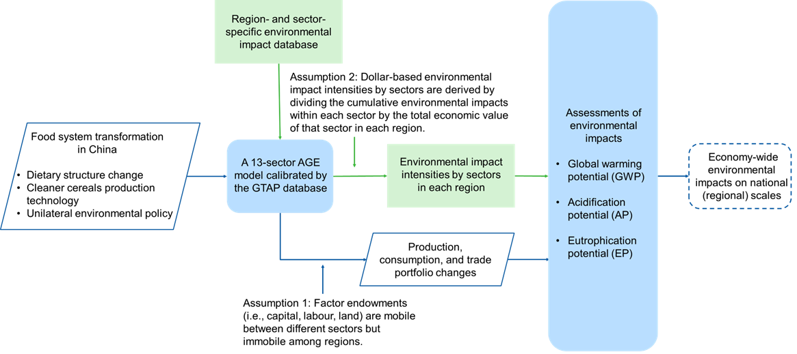
Paper 1: Exploring sustainable food system transformation options in China: An integrated environmental-economic modelling approach based on the applied general equilibrium framework
(Long et al., 2024, Sustainable Production and Consumption, Accepted)
Notes:
A nexus approach is needed to understand the synergies and trade-offs for alternative solutions.

Slide 8

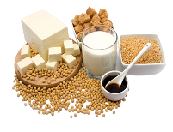



Scenarios of paper 1
Scenario 2 (S2)
A partial shift from pork to soy-based food
Differences in environmental concerns
Scenario 3 (S3)
Cleaner cereals production technology
Baseline
(S0)
Scenario 1
(S1)
Scenario 4 (S4)
Combination of dietary shift and cleaner cereals production
Scenario 5 (S5)
3% reduction
Emission restriction policy
(Long et al., 2024, Sustainable Production and Consumption, Accepted)

Slide 9





Paper 2: A modest mitigation target could address rebound effects of upcycling food waste as feed in China while safeguarding global food security
Global food waste drive greenhouse gas (GHG) emissions
Around 1.3 billion tonnes of food waste are produced in the world, which are mainly disposed in landfills and incinerators, and are a significant source of greenhouse gas (GHG) emissions (Gustavsson et al., 2011).
Environmental benefits of feeding animals with food waste
Feeding animals with food waste can possibly reduce GHG emissions, mitigate land pressures, and alleviate food-feed competition (Van Zanten et al., 2018; Van Hal et al., 2019; Fang et al., 2023).
Contribution to Sustainable Development Goals (SDGs)
It may to achieving Sustainable Development Goals (SDGs), including SDG 2 (zero hunger), SDG 6 (clean water and sanitation), SDG 12 (responsible consumption and production), SDG 13 (climate action), and SDG 15 (life on land) (UN, 2025).
Indirect and spillover effects not covered in previous studies
Rebound effect: Lower feed costs may expand livestock production and increase emissions. Knock-on effects: It may exacerbate emissions further. Food security: Addressing rebound effects while ensuring food security remains unclear.
Why China?
46% of global pork production
34% of global egg production
13% of global poultry meat production
27% of food produced is wasted

Slide 10




Applied general equilibrium models with food waste
Production
Food waste treatment
Food waste recycled as animal feed
Cereals
Vegetables & fruits
Roots & tubers
Oilseeds & pulses
Food waste recycling service
Food waste collection service
Sugar
crops
Other non-food crops
Ruminant livestock
Monogastric livestock
Cereal
bran
Alcoholic pulp
Oil
cake
Compound feed
Collected
food waste
Processed
food
Nitrogen fertiliser
Phosphorous fertiliser
Non-food
Food waste generation
Goods
Consumption
Food waste:
Cereals waste
Vegetables & fruits waste
Roots & tubers waste
Oilseeds & pulses waste
By-products waste:
Cereal bran waste
Alcoholic pulp waste
Oil cake waste
Food waste
Households
By-products waste
The consumer price of food includes both the market price of food and the cost of collecting food waste by the municipality.
Food waste disposed in incinerators and landfills

Slide 11
Scenarios of paper 2
Scenarios | Food waste as feed | Emission mitigation target
S1: Partial use of food waste as feed | Food waste: 54% By-products: 100% | No
S2: Full use of food waste as feed | Food waste: 100% By-products: 100% | No
S3: S1 + A modest emission mitigation target | Food waste: 54% By-products: 100% | Implementing economy-wide emission taxes to ensure that emissions of greenhouse gases, acidification pollutants, and eutrophication pollutants in both China and its trading partners do not exceed their baseline (S0) levels.
S4: S1 + An ambitious emission mitigation target | Food waste: 54% By-products: 100% | Implementing economy-wide emission taxes to meet their annual mitigation target of the Intended Nationally Determined Contributions (INDC) under the Paris Agreement and the “13th Five-Year Plan”.

Slide 12
Paper 3: Food system transformation is key to achieving food security and environmental sustainability in China
Scenarios | Descriptions
S1: Crop supply-side option | Improving crop production efficiency through Integrated Soil-crop System Management technology (ISSM).
S2: Livestock supply-side option | Upcycling food waste as feed in monogastric livestock production.
S3: Demand-side option | Shifting towards less meat-intensive diets based on the EAT-Lancet diet recommendation.
S4: S1+S2+S3 | Combing crop and livestock supply-side as well as demand-side measures.

Slide 13
Paper 4: Exploring transformation options in the food-land-water-climate nexus: towards achieving multiple SDGs in China
Scenarios | Descriptions
Food scenario | Shifting towards less meat-intensive diets based on the EAT-Lancet diet recommendation in line with SDG 2 (zero hunger).
Land scenario | An afforestation policy based on China’s National Forest Management Plan (2016–2050) in line with SDG 15 (life on land).
Climate scenario | A carbon tax in line with the Paris Agreement as well as the PB on climate change and SDG13 (climate action).
Water scenario | Improving crop production efficiency up to the levels of developed countries in line with SDG 6 (clean water and sanitation).
Combined scenario | Combining food, land, water, and climate scenarios.

